Slide 1
Pseudonymisation in ResearchOne Projects
Samantha Crossfield
d info@researchone.org
d
Head of ResearchOne, TPP
Yorkshire Centre for Health Informatics, University of Leeds

Slide 2
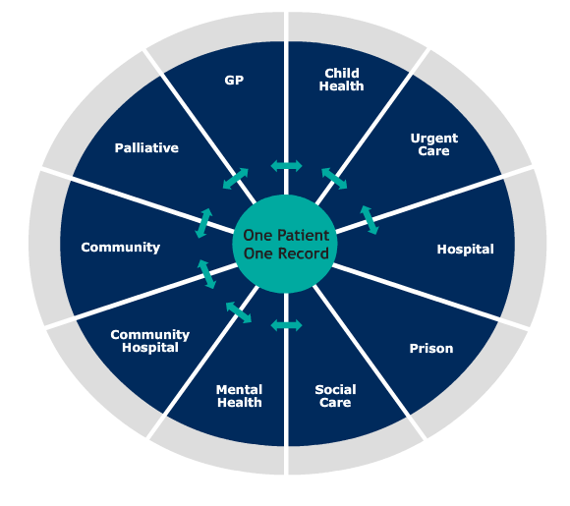
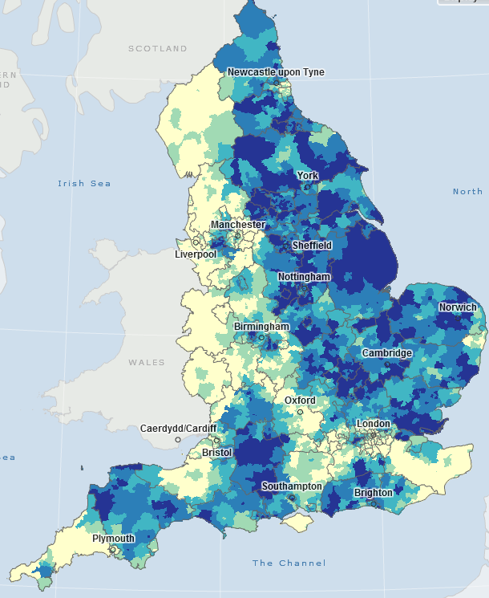
Overview
High-quality, ethically-approved database for health and care research
Potential for over 27 million research records from SystmOne
Not-for-profit enterprise, cost-effective data
De-identified, pseudonymised database with ethical approval
Provider opt-in, patient opt-out
Support researchers, clinicians and commissioners
How can we help the NHS?
How can we improve healthcare?
Permanent registered GP patients on SystmOne

Slide 3
Ethics, Confidentiality, Security
5 year approval from NRES
With advice from CAG/CAT (ECC) that the data is suitably de-identified
Provider opt-in, Patient opt-out
Database & project committees
De-identification, pseudonymisation, K-anonymity,…
Industry standard encryption (e.g. AES 256)
Leverage existing TPP infrastructure

Slide 4
Iterative Feedback Loop
Live Environment
Public Health Surveillance
Anonymised Data Extracts
SystmOne Live Backup
ResearchOne
Data Centre 1
Analytic work
Weekly
ResearchOne Link
Data Centre 1
Data Centre 2

Slide 5
ResearchOne Pseudonymisation
OpenPseudonymiser is the standard for ResearchOne pseudonymisation
Runs on the database via the open source script
SystmOne ID→ automatic pseudonymisation → ResearchOne ID
ResearchOne ID + project-specific salt → Project ID

Slide 6
Cohort Pseudonymisation
Ethically approved cohort studies provide ResearchOne with Pseudo-IDs
Pseudonymised information is returned for that cohort

Slide 7
Some Recent Work
Born in Bradford
13,000 families: how genetic, environmental and social factors impact health. The project uses Child Health and General Practice data
Improving Prevention of Cardiovascular Events in Primary Care
Cardiovascular risk in mental health care
Steve Magare, IMPROVE-PC
“ResearchOne will allow research projects such as this to realise the full potential of using linked data to improve healthcare in an efficient and cost effective manner.”
John Wright, Born in Bradford
“ResearchOne has the potential to transform medical research by providing low cost methods to monitor the impact of exposures such as air pollution and diet on later health”

Slide 8
Some Current Work
Development of a frailty index based on routinely collected primary care data
Identifying prognostic markers in patients with chronic heart failure
RCGP swab virology and primary care surveillance
Diagnostic efficacy of the 2010 NICE Guidelines on chronic heart failure
Bradford Teaching Hospitals Foundation Trust
Faculty of Medicine & Health, University of Leeds
RCGP
University of Leeds, ResearchOne

Slide 9
Questions?
Email: info@researchone.org

